Slide 1

Estate Planning for individuals with disabilities
Presented by
Ellen Cookman, Esq.
Cookman Law, PC
Palo Alto, CA
www.cookmanlaw.com

Slide 2
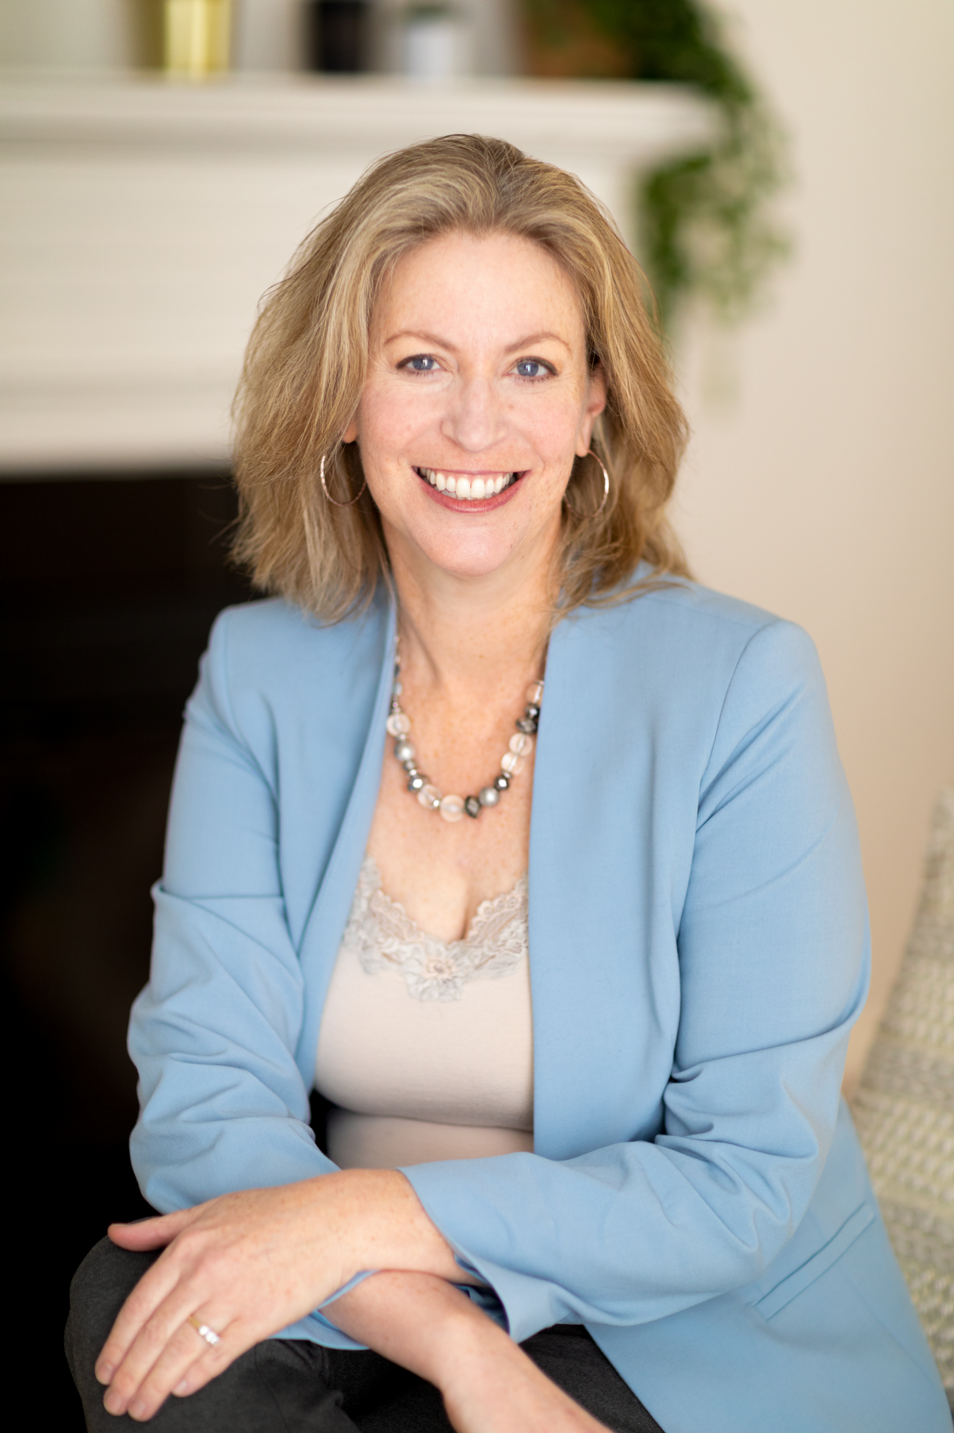
Ellen S. Cookman, Esq.
Certified Specialist, Estate Planning, Trust and Probate Law, The State Bar of California Board of Legal Specialization
Principal at Cookman Law, PC
J.D., UC Berkeley School of Law
LL.M. in Estate Planning, Trust and Probate, Golden Gate University
Law Clerk, Chief Judge Anthony J. Scirica, Third Circuit Court of Appeals (Philadelphia, PA)
California State bar No. 227833
Parent of child with special needs

Slide 3

Estate planning goals
one
two
Protect yourself
Maximize quality of life
Maximize independence
four
three
five
Maximize public benefits
Avoid court system

Slide 4




Which public benefits does child receive?
Income Stream
Health Insurance
Supplemental
Security Income (SSI)
Resource Limit: $2000
Income limit: $1,183/mo
Earned income decreases SSI 50¢/every $1 of income; unearned income decreases SSI $1/every $1 of income
Medi-Cal
(Medicaid)
Resource Limit: None (as of 2024)
Income Limit: approx. $1,732/mo
Includes earned and unearned income
$1
Social Security
Disability (SSDI)/CDB
Resource Limit: $2000
Income limit: $1,470/mo
Only earned income interferes
Medicare
Resource Limit: None
Income limit: None
Note: higher income → higher monthly adjustment amount
2 years

Slide 5

1
special needs trusts

Slide 6
What is a special needs trust?
Irrevocable trust
Holds assets for your benefit
Someone else (not you) acts as Trustee
DOES NOT interfere with your public benefits
Like a safety net!

Slide 7
3 types of special needs trusts
Type of SNT | Source of Funds | Who Establishes | Distribution on Death
First Party (d)(4)(A) SNT | Your funds before age 65 | You, parent, grandparent, Guardian, Court | Medi-Cal payback; then remainder beneficiaries
(d)(4)(C) Pooled SNT | Your funds | You, parent, grandparent, Guardian, Court | Non-profit Trustee; or, Medi-Cal payback, then remainder beneficiaries
Third Party SNT | Anyone except your funds | Anyone except you | Grantor’s wishes

Slide 8

WHO USUALLY ACTS
AS trustee?
Family member
Friend
Private Professional Fiduciary
Bank
Nonprofit
Pooled Trust
Combination

Slide 9

2
Able accounts

Slide 10
What is an able account and why able?
ABLE (Achieving a Better Life Experience)
Accounts are tax-advantaged savings accounts for you and your families.
Save for disability-related expenses (with Medi-Cal payback requirement, but not in CA);
Earned income grows tax-free and qualified withdrawals are tax-free; and
Does not interfere with your public benefits (with limitations)
Contribution limits of $18,000 per year (as of 2024) from all sources.

Slide 11
Able account: Who is eligible?
You must have a “qualifying disability,” and
Your disability must have manifested before age 26 (up to age 46 in 2026)

Slide 12
Able account: limitations
To be used only for “qualified disability expenses”
You can establish only one ABLE account
You or an Authorized Legal Representative (ALR) can manage the account
SSI suspended if total amount in account exceeds $100,000, but you can continue to receive Medi-Cal

Slide 13
Able account: other DETAILS
Your 529 savings account can be rolled over into your ABLE account up to $18,000/year (until 2026).
If you are earning income from employment, you can contribute more than $18,000 annual cap, up to the Federal Poverty Level, currently $15,060 for a single person, if not participating in employer’s retirement plan.
California residents using CalABLE accounts won’t have a Medi-Cal reimbursement claim upon their death; ABLE accounts established in other states (starting 1/23) WILL be subject to reimbursement claim

Slide 14
What is a qualified disability expense?
- Education
- Health and wellness
- Housing (should be spent in same month as withdrawn from ABLE account)
- Transportation
- Legal Fees
- Financial Management
- Employment training and support
- Assistive Technology
- Personal support services
- Oversight and monitoring
- Funeral and burial expenses
A Qualified Disability Expense is ANY expense that is incurred as a result of living with a disability and is intended to improve quality of life. Qualified expenses include, but are not limited to:

Slide 15
Able account vs. 1st party snt
Issues | ABLE Account | 1st Party SNT
Who can use? | You, if your disability began before age 26 (increases to age 46 in 2026) | You, if you are disabled and under age 65
Who can fund? | Anyone, including you | You, conservator, guardian, agent, court
How many can you have? | One | Unlimited
Who can control? | You, guardian, Conservator, or agent | Anyone except you and your spouse
Medi-Cal Payback | No (if you’re using CalABLE account) | Yes
Who can inherit on your death? | Your estate | Whomever is named in the document

Slide 16
Able account vs. 1st party snt (2)
Issues | ABLE Account | 1st Party SNT
How much can be funded in a year? | $18,000 (or annual gift exemption) | Unlimited
Is funding gift tax-free? | Yes | No
Is there a cap on how much can be in an account? | Yes, currently $100,000 limitation for SSI recipients and up to state 529 plan limits for Medicaid only recipients | No
How is income taxed? | No income tax | Taxed at your tax rate
What type of distributions can be made? | Only “qualified disability expenses” | For your primary benefit

Slide 17
setting up a calable account
CalABLE Website
Required information:
Your SSN;
Authorized legal representative’s SSN; and
Bank account information.
Access to Funds
Reloadable, prepaid Visa debit card is now available
You can set up an account on the CalABLE website:
https://www.calable.ca.gov/

Slide 18

3
Power of attorney

Slide 19
Durable power of attorney (“dpa”)
You (the Principal) give someone the ability to sign financial documents
Your Power of Attorney can:
  Access your bank accounts, talk with public benefits programs, pay your bills, etc.
Forms are available online, but are often incomplete.
Some powers must be spelled out (i.e. gifting powers)

Slide 20
Issues with dpas
Principal can revoke the DPA
Banks often don’t accept forms
Substitute decision-making – it is not empowering

Slide 21

4
Advance health care directive

Slide 22
Advance health care directive (“ahcd”)
  You name someone to advocate on your behalf if you are unconscious in the hospital.
  Access medical records
  Spells out your decisions:
    “Keep me alive” or “let me go?”
    Organ donations?
    Burial/cremation/green burial?
  You can revoke it!

Slide 23
POLST & DNR forms
  An Advance Health Care Directive is different from the POLST and DNR forms.
  POLST (“Physician Orders for Life-Sustaining Treatment”) is a medical order form signed by a doctor that outlines a patient’s preferences for end-of-life care.
  DNR (“Do not Resuscitate”) is part of the POLST form and instructs healthcare providers not to perform CPR if a patient's breathing or heart stops.

Slide 24

About
Cookman Law, PC
Palo Alto law firm serving all of California
3 attorneys, 10 support staff
We charge a flat fee for estate planning and special needs planning
We do not assist with applications for public benefits

Slide 25



CONNECT WITH US!
YouTube
Facebook
LinkedIn
Ellen Cookman - Special Needs Trust Attorney
@PaloAltoEstatePlanner
Ellen Cookman, JD, LL.M

Slide 26
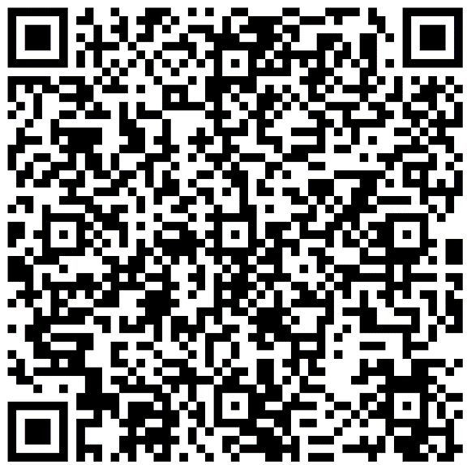
Thank you!
Thank you for your attention!
Please contact us for further information:
650-690-2571
info@cookmanlaw.com
www.cookmanlaw.com
Scan the QR code to request a copy of the slides for this presentation and be added to our monthly mailing list.

